Slide 1
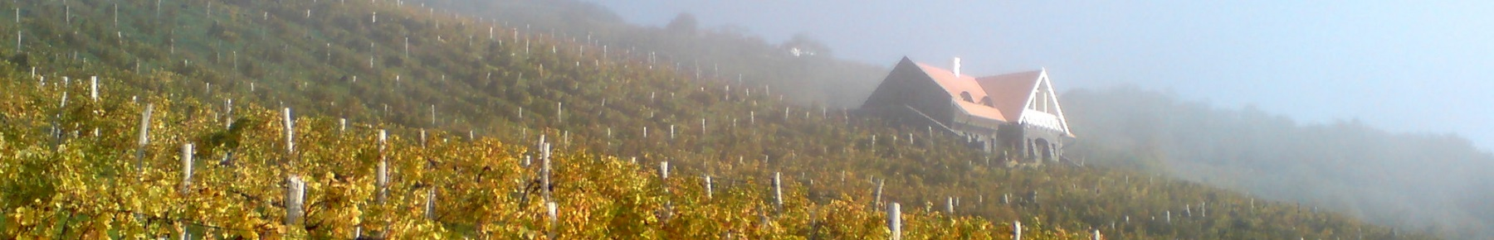
Villa Sandahl introduction
Christer Sandahl

Slide 2
Our success story in short
We “happened” to :
1985 Learn about wines from all the world
2004 Find a world class 3.3 ha vineyard in Badacsony
2006 Acquire Alsace vinification process for white dry wines
2007 Get house building permission in the vineyard
2008 Adapt the famous Riesling to vineyards and rich wines
2010 Extend with another world class 7 ha vineyards
2010 Break through with excellent wines in poor vintage
2011 Be discovered by Michelin restaurants in Budapest
2012 Sell to prestigious Hungarian retailer Bortársaság

Slide 3
Our Vision
Villa Sandahl's vineyards have the potential to bear such grapes,
which vinified by the best equipment and methods available,
result in wines with chance to be recognized on the word market,
as one of the best dry white wines.

Slide 4




Some model companies
Innovative as:
Competitive as:
Attractive as:
Wilful as:

Slide 5
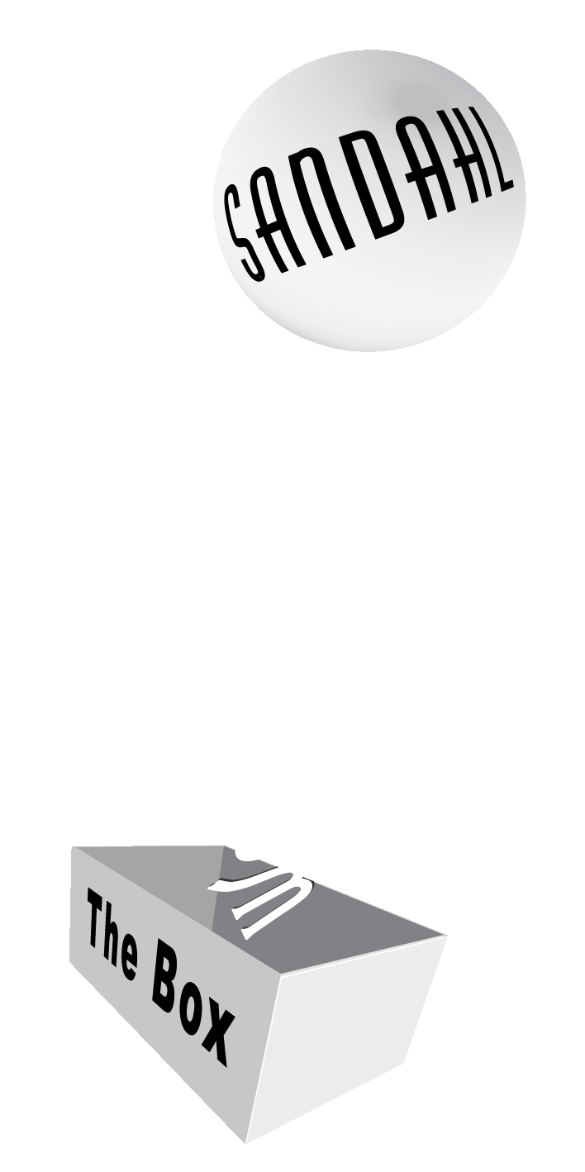
We don’t conform
Taking entrepreneurship and some capital to Hungary
Entering wine production without formal degrees
Matching varieties with vineyard potential and market demand
Applying French ‘state of the art’ winemaking
Applying unique labels for each vintage, vineyard and variety
Ramp-up company without fashion-able media and marketing experts
Here is
Villa Sandahl
Here are our conventional competitors

Slide 6
Our business strategy
Villa Sandahl owners are extremely quality driven
High quality means good margins but limits volume demand
Therefore Villa Sandahl opts for small but excellent vineyards
Volume
Margin
Villa Sandahl

Slide 7
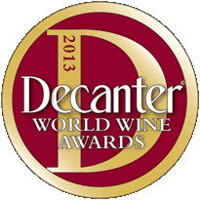
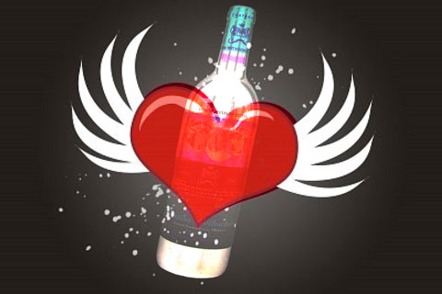
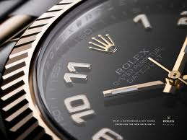
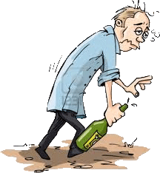
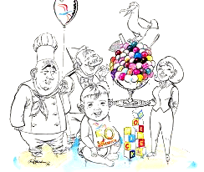
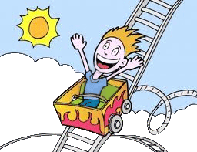
Wine consumer segments
4. Enthusiast
5. Passionate
6. Prestige
Drink to get excitement
wine more important than food
Drink to become a wine nerd
wine more important than people
Drink to show power
e.g. celebrate a signed contract
3. Emotional
1. Booze
2. Social
Drink to get drunk
wine more important than yourself
Drink to get more sociable
people more important than wine
Drink to make life richer
food and wine are important

Slide 8

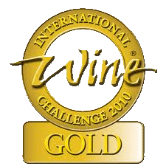
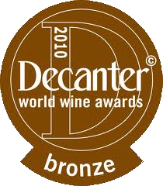

Villa Sandahl target groups
End consumer segments
Facilitators
Upper of
3. Emotional
Whole of
4. Enthusiast
Lower of
5. Passionate
Sommeliers
Wine critics
Wine competitions
Journalists

Slide 9
Villa Sandahl wine style
Upper segment wines
  Sugar 4 – 6 g/l (dryer)
Lower segment wines
  Sugar 6 – 9 g/l (dry)
Moderate acidity
  ripe and smooth (5 – 7 g/l)
Some volatile acidity
  for flavor (~ 0,5 g / l)
Extract (glycerol, minerals, aroma etc.)
Alcohol
13 % ~ 14 %
~ 105 g/l
Acidity ~ 7 g/l
Vol. acidity ~ 0.6 g/l
Sugar
3 - 5 g/l
5 - 9 g/l

Slide 10
Quality corner stones
Have a vision and a realistic formal process
Cope with your worst weaknesses first
Follow up everything and always take action
Analyze root cause and be brutally honest
Money alone doesn’t increase quality
Get only the right people into your network
Manage and explain, nothing come by itself
Trust yourself, don’t be afraid to be out of the box

Slide 11
Entrepreneurship
Work in teams
Cover for each other
Organize efficiently
Care for the wallet
Be prestigeless
Value experience
Don’t wait to warn
Plan and follow-up
Long and short term
Educate suppliers
Exceed customers' expectations
Be proud of success
Similar to agile and lean concepts

Slide 12

The quality chain
Market
Image
Bottling
Stabilization
Fining
Correction
Tasting
Analyses
Yeast
Temperature
Sulfur
Tank
Fractions
Pressure
Press
Transport
Oxidation
Harvesting
Harvest time
Pruning
Binding
Variety
Climate
Drainage
Soil
Strategy

Slide 13
Significance of the vineyard
In the vineyard the grape quality originates
In the winery this quality must be refined
Compare with cooking:
  By poor cooking you can destroy a beef fillet,
  to get worse than a pork neck
  Whereas, whichever way you cook a pork neck,
  a beef fillet can always get better

Slide 14
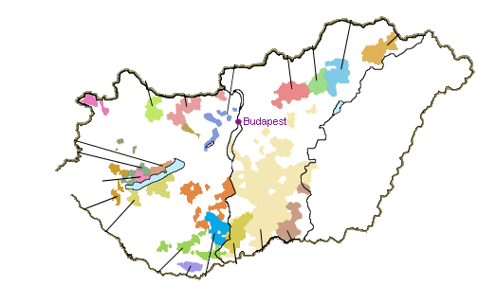
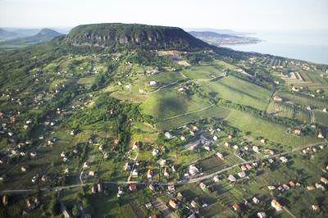
Badacsony hill
Eger
Bükkalja
Tokaj-
Hegyalja
Mátraalja
Pannonhalma-
Sokoróalja
Etyek-
Buda
Ászár-
Neszmély
Sopron
Balatonfüred-
Csopak
Balaton-felvidék
Somló
Mór
Badacsony
Tolna
Balatonmelléke
Balatonboglár
Csongrád
Mecsekalja
Kunság
Villány
Hajós-Baja
Szekszárd

Slide 15
New trellis
194 cm
190 cm, Ø = 2,2 mm
140 cm, Ø = 2,2 mm
50
~ 4
100 cm, Ø = 2.5 mm
~ 600
80 cm, Ø = 2,0 mm
190
wood pole
50
200
~ 6 m with 5 vines
100
Ø = 8 cm
50
Ø = 12 cm
200
- 56 cm
100
50
Ø = 12 cm

Slide 16
Why Rhine Riesling
Our south facing, steep and sandy vineyards are hot and dry for white varieties
Most varieties harvested under such conditions:
  Chemistry balance much earlier than ripeness
Riesling naturally preserve higher acidity and more slowly build sugar
  Chemistry balance match optimal ripeness
Green
taste
Preferred
ripe taste
Riesling acidity
Low acidity variety
Preferred
balanced chemistry
High sugar variety
Riesling sugar
Grapes unripe
Grapes overripe

Slide 17
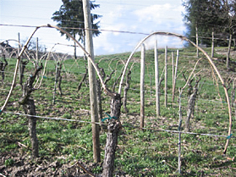
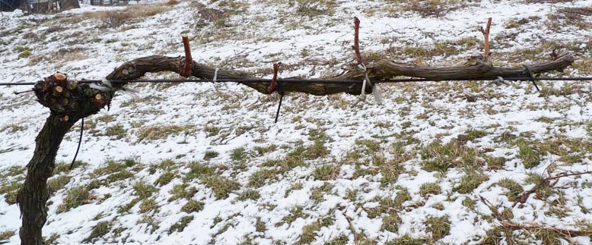
Pruning improvements
Cane pruning
Spur pruning

Slide 18
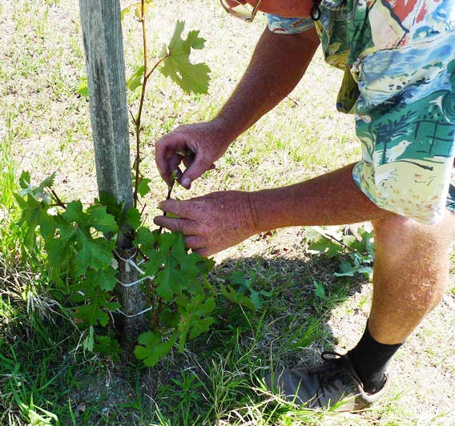
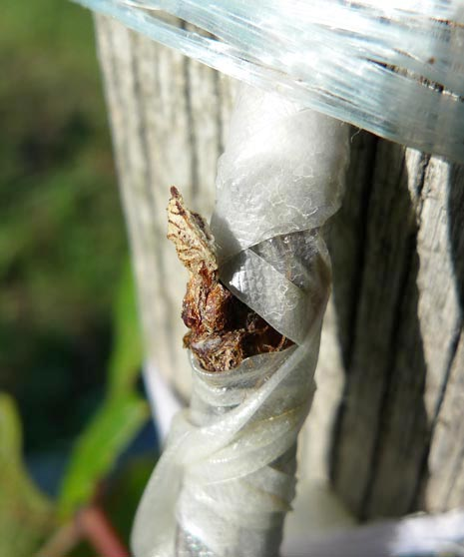
Engrafting

Slide 19
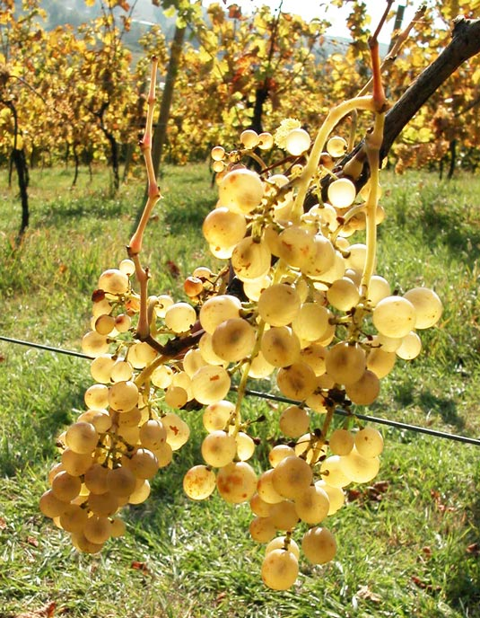
Harvest
Harvest must wait until :
Grapes has lost their unripe greenness
Harvest must be done before :
Too much sugar
  Also from too much botrytis
Too low acidity
Winter with bad weather sets in
  Grapes stops to ripen,
  but may shrivel or rot

Slide 20
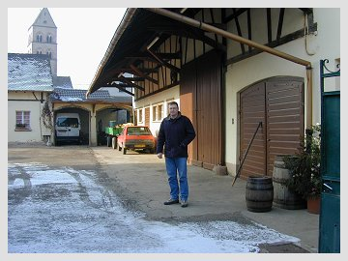
Oenologist consultant
Fabien Stirn
  Top wine producer in Alsace
We took Alsace processing
  Pressing scheme
  Pressing fractions
  Temperature profile
  Stabilization

Slide 21
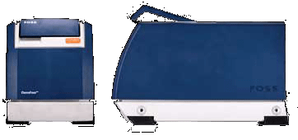
Measurements
Oenofoss instrument
  Measurement in 30 seconds
  Appropriate accuracy
  Used since 2008
Analysis
Glucose + Fructose
pH
Total Acid
Malic Acid
Ethanol
Volatile Acid

Slide 22
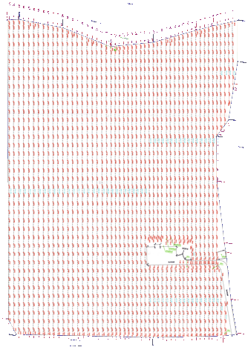
Genesis partitioned according to quality
Genesis
high
Partitions harvested and pressed at different time
Partitions fermented separately
To create some partitions to get better than the blend would have been
To be pruned differently to optimize quality
Genesis grafted
Genesis grafted
Genesis
low

Slide 23
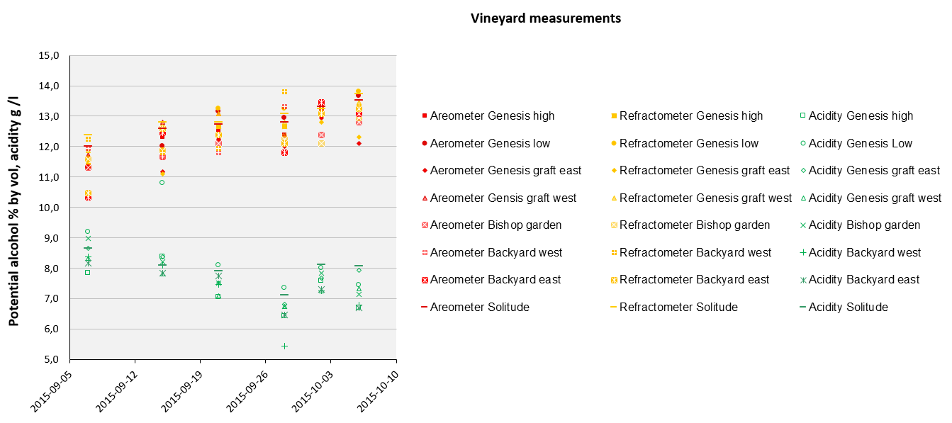
Measuring in the vineyards

Slide 24
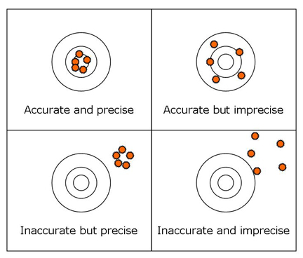
Measuring for optimal harvest time
Difficulties to make grape sample measurements to emulate real wine outcome
1. different bunches, vines, microclimate
Sampling grapes to be statistically representative
Pressing samples to emulate real pressing
Settle samples to emulate real tank sedimentation
Transformation of sugar to alcohol more efficient than theoretical predictions
Outcome
2, 3, & 4 emulated pressing, deposition, fermentation

Slide 25
Initial juice separation
Press
4th fraction
- inferior juice
3rd fraction
- ordinary juice
Self run
- dirty juice
2nd fraction
- premium juice
1st fraction
- superior juice

Slide 26
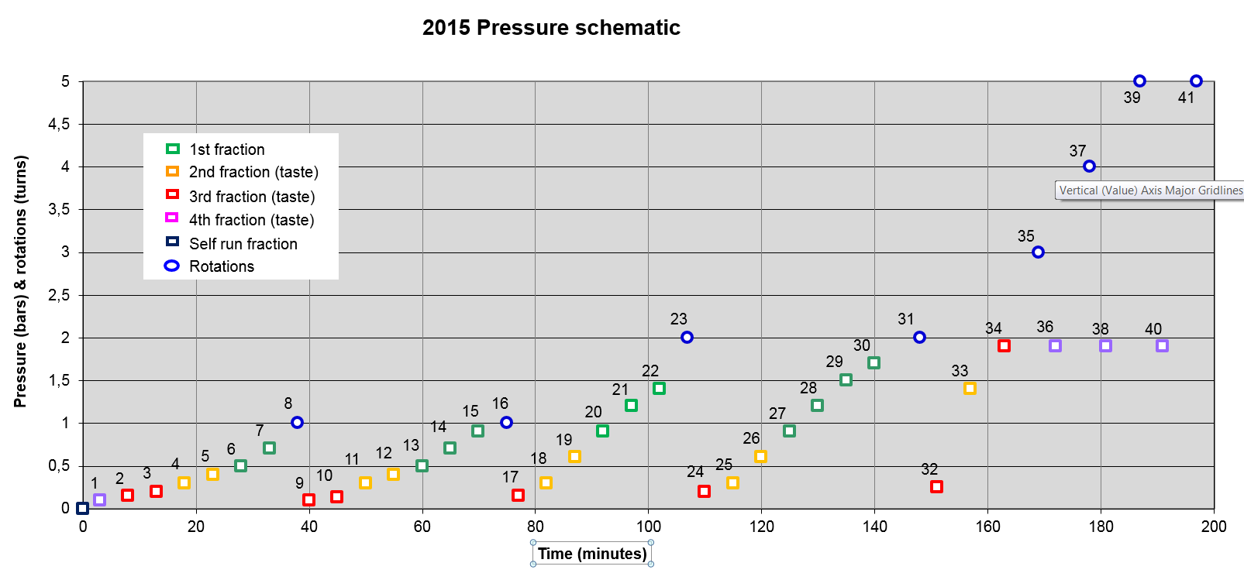
Pressing scheme
1st quality
2nd quality (taste)
change to 1st quality
3rd quality (taste)
Self run
Rotations

Slide 27
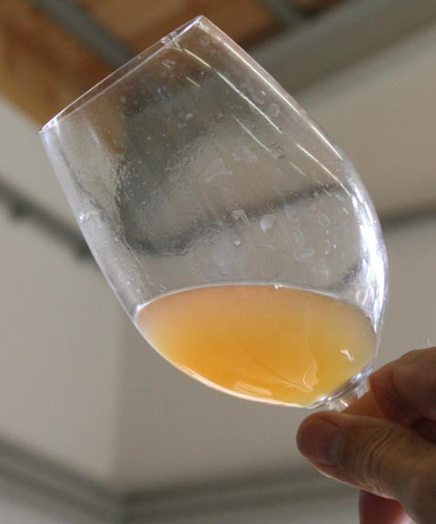
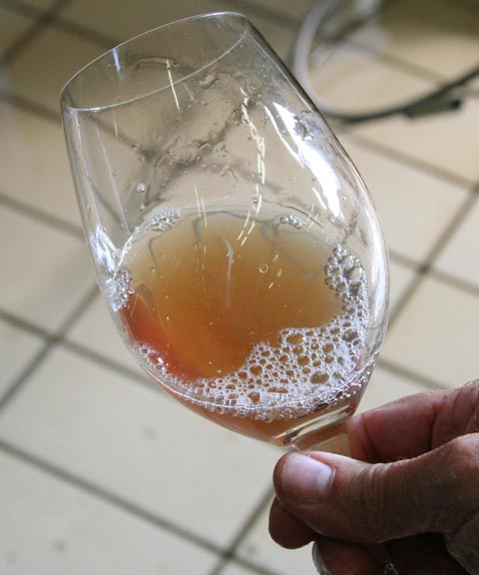
Clear and cloudy juice
Second fraction juice
First fraction juice

Slide 28
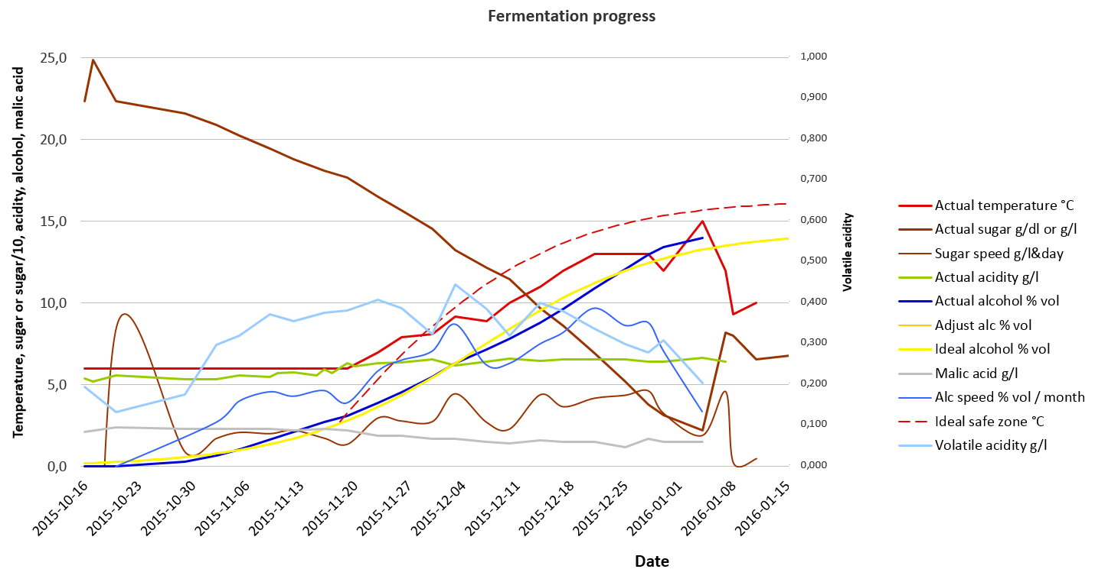
Fermentation monitoring

Slide 29
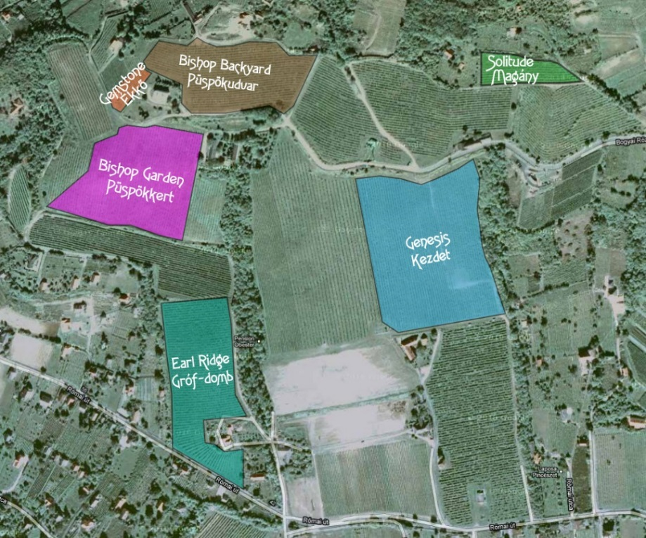
Tank assemblage to portfolio offer
Quality grades
Flagship
  Single variety
  Single vineyard
  (or part of vineyard)
  Often only 1st fraction
Premium
  Possible blend of varieties
  Possible blend of vineyards
  Often 2nd fraction, possible addition of 1st fraction
Base
  Young or recently grafted vines
  Blended 3rd fractions

Slide 30
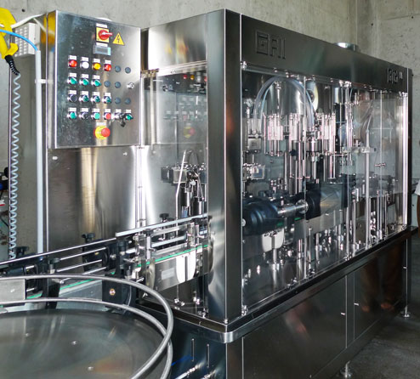
Bottling
Apart from pressing, bottling is the most crucial
After corking, the content in the bottle may not contain anything living, such as yeast or bacteria
Sterile filtering is applied (even on rinse water)

Slide 31
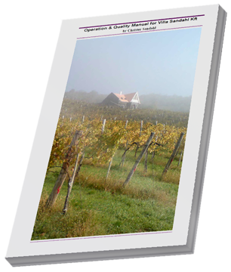
Quality manual
130 pages
Detailed description of all links in the quality chain
Updated regularly
Not for sale :- )

Slide 32
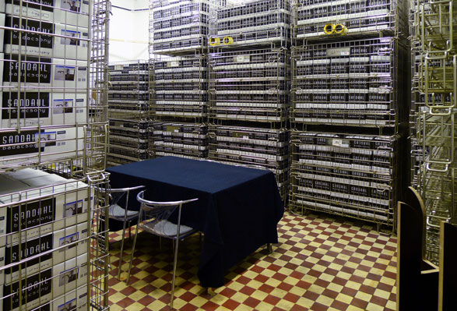
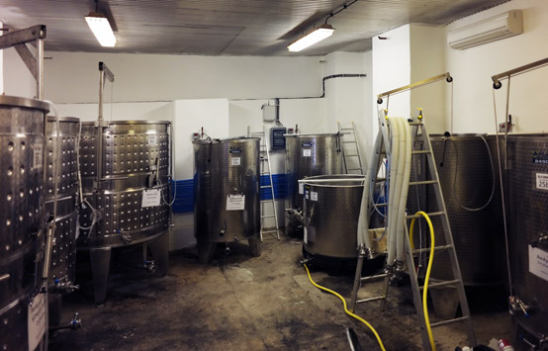
Our own winery
140 m²
Wine storage and tank room
Not yet press and bottling machine
Simple layout but appropriate functionality

Slide 33
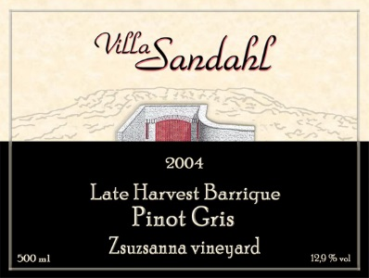
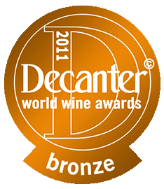

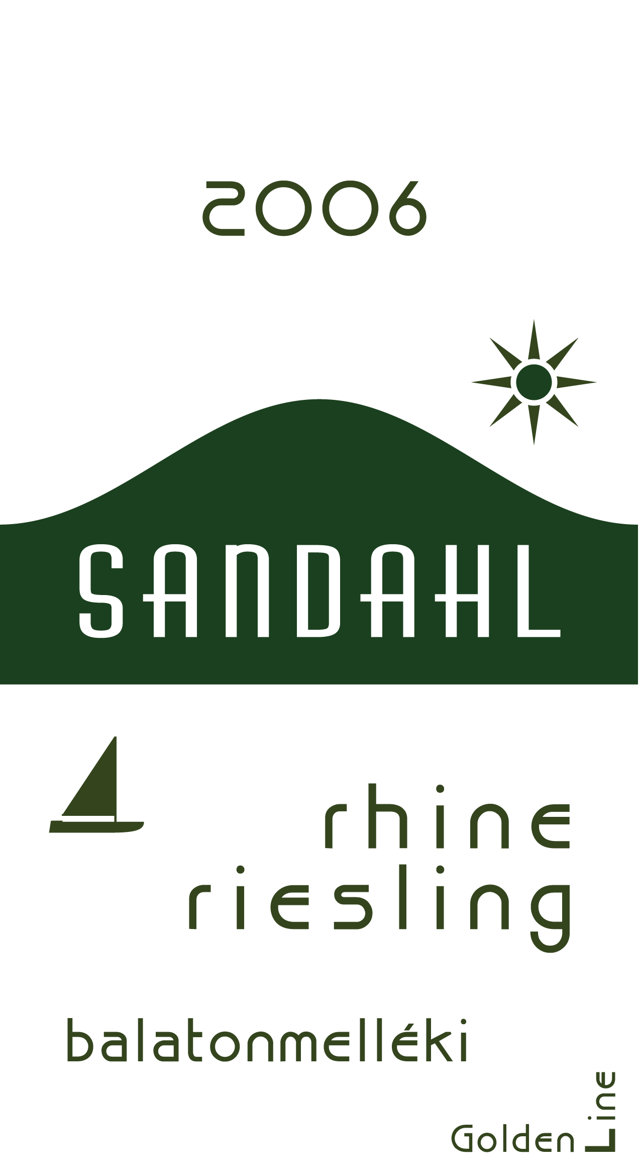
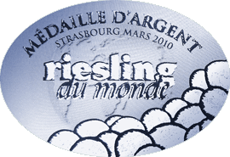
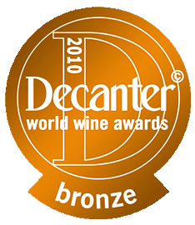
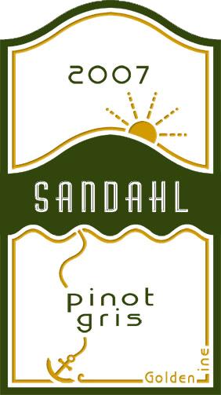

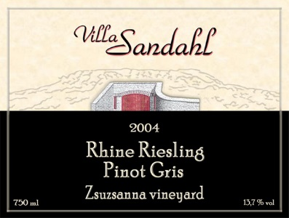
Early era up to 2008
2004 Villa Sandahl
Late Harvest Barrique Pinot Gris
2008 Sandahl
rhine riesling GL
2006 Sandahl
rhine riesling GL
2004 Villa Sandahl
Rhine Riesling Pinot Gris
2008 Sandahl
rhine riesling SL
2007 Sandahl
pinot gris GL

Slide 34

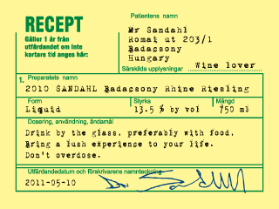
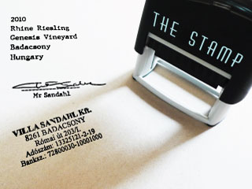

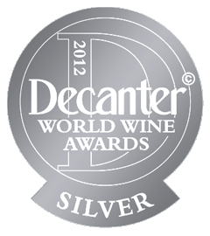
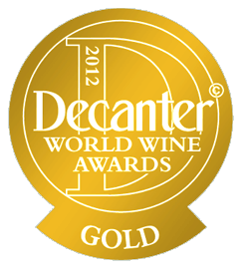

Break through 2010 vintage (theme: get going)
Premium
Flagship
2010 Sandahl
rhine riesling ‘recept’
2010 Sandahl
rhine riesling ‘the stamp’

Slide 35
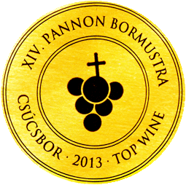
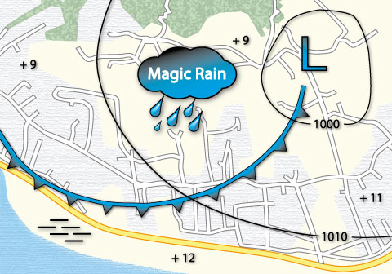
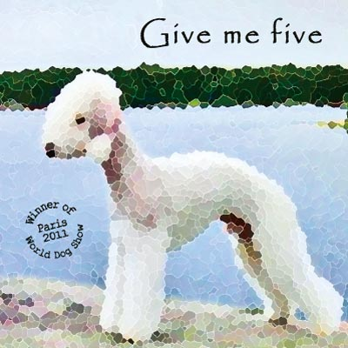
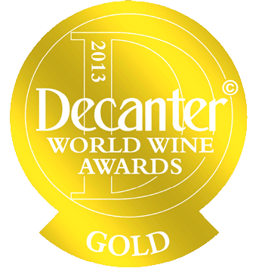
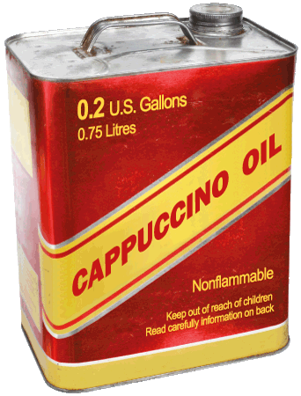

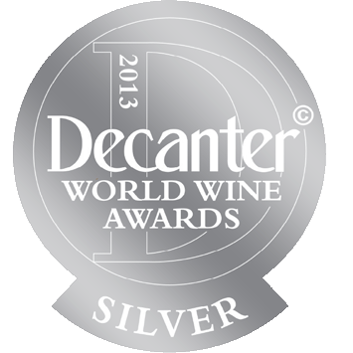

Wines from 2011 vintage (theme: events)
Flagship
Premium
Premium
20 1 1 Sandahl
rhine riesling ‘magic rain’
20 1 1 Sandahl
olasz riesling ‘give me five’
20 1 1 Sandahl
rhine riesling ‘cappuccino oil’

Slide 36
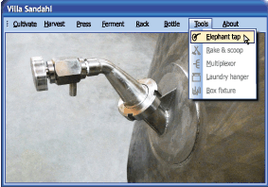
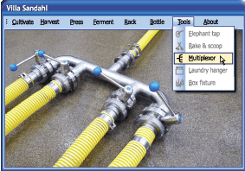





Wines from 2012 vintage (theme: windows)
Base
Premium
Base
20 1 2 Sandahl
rhine riesling ‘elephant tap’
Premium
20 1 2 Sandahl
rhine riesling ‘multiplexor’
Flagship
20 1 2 Sandahl
olasz riesling ‘box fixture’
20 1 2 Sandahl rhine riesling ‘rake & scoop’
20 1 2 Sandahl rhine riesling ‘laundry hanger’

Slide 37








Wines from 2013 vintage (theme differences)
Premium
Premium
Base
Premium
20 1 3
Sandahl
rhine riesling
‘gold standard’
20 1 3 Sandahl
rhine riesling
genesis
‘count
down’
20 1 3 Sandahl
rhine riesling
bishop backyard ‘secret’
20 1 3 Sandahl
rhine riesling
‘all of a kind’

Slide 38


Wines of 2014 vintage (theme: flooded)
Premium
20 1 4 Sandahl rhine riesling genesis ‘sos’
20 1 4 Sandahl rhine riesling genesis ‘mms’
Base

Slide 39








Wine from 2015 vintage (theme: fragrancy)
20 1 5 Sandahl rhine riesling
genesis high ‘citrus x limon’
Flag-
ship
Flag-
ship
20 1 5 Sandahl rhine riesling
bishop backyard ‘dry honey’
20 1 5 Sandahl rhine riesling
genesis ‘wet stones’
2nd high
1st
1st high
Premium
1st low
20 1 5 Sandahl rhine riesling
bishop backyard ‘bear glue’
2nd
20 1 5 Sandahl rhine riesling
‘bella sunrise’
3rd low + high
1st 2nd 3rd
2nd low
3rd
Premium
Base
Base
20 1 5 Sandahl rhine riesling
‘tussilago farfara’

Slide 40




2016 vintage wines (theme: Asia)
Flagship
20 1 6 Sandahl
rhine riesling
‘Chicken Year’
20 1 6 Sandahl
rhine riesling
‘Tie mania’
Premium
Base
20 1 6 Sandahl
rhine riesling
‘Banana split’
Premium
20 1 6 Sandahl
rhine riesling
‘Street smart’

Slide 41




2017 vintage wines (theme: magic)
20 1 7 Sandahl
rhine riesling
‘Rabbit periscope’
Flagship
20 1 7 Sandahl
rhine riesling
‘Ball of Fame’
Premium
20 1 7 Sandahl
rhine riesling
‘Crystal Cut’
Base
Premium
20 1 7 Sandahl
rhine riesling
‘Shop stop’

Slide 42


Labels for Sweden (theme: censored)
“- Does this wine contain cappuccino or alcohol ?”
“- No !”
“- Then you may not call
it Cappuccino oil !”
“- But then I call it No cappuccino and no oil !”
“- Does this wine normally contain cappuccino or oil ?”
“- No !”
“- Then you may not call it No cappuccino and no oil !”
“In Sweden it is forbidden to prescribe alcohol”
2010 Sandahl
rhine riesling ‘accept’
20 1 1 Sandahl
rhine riesling ‘wine can surprise’

Slide 43







Current retailers
Hungary
Badacsony
Austria
Sweden

Slide 44


Michelin star restaurants in
Budapest

Slide 45

Retailers are one link in our quality chain
Help us keep the chain intact all the way to the end consumer !

Slide 46





Villa Sandahl network
Lund
Sweden
Lund
Sweden
Värnamon
Sweden
Christer Sandahl
+46 733 736008
christer@sandahl.com
Gunnel Sandahl
+46 708 152538
gunnel@sandahl.com
Thord Sandahl
+46 733 736010
thord@sandahlsbolagen.se
Badacsony
Hungary
Badacsony
Hungary
Zsolt Palkó
+36 30 530 4739
zsolt.villasandahl@gmail.com
Judit Mozdeny
+36 70 610 7255
mozdenyjudit.villasandahl@gmail.com

